Slide 1
CHE 320 Lab 14 Solution

Slide 2
Step 1: Know your resources
For Design of Experiments (DOE)
JMP (or Minitab or a similar statistical software)
For coded to real values and other intermediate analysis
Excel
For the production data
https://engineering.purdue.edu/~che320/labs/lab13/reactor/
All values are based on values generated in the website on Nov 22nd

Slide 3
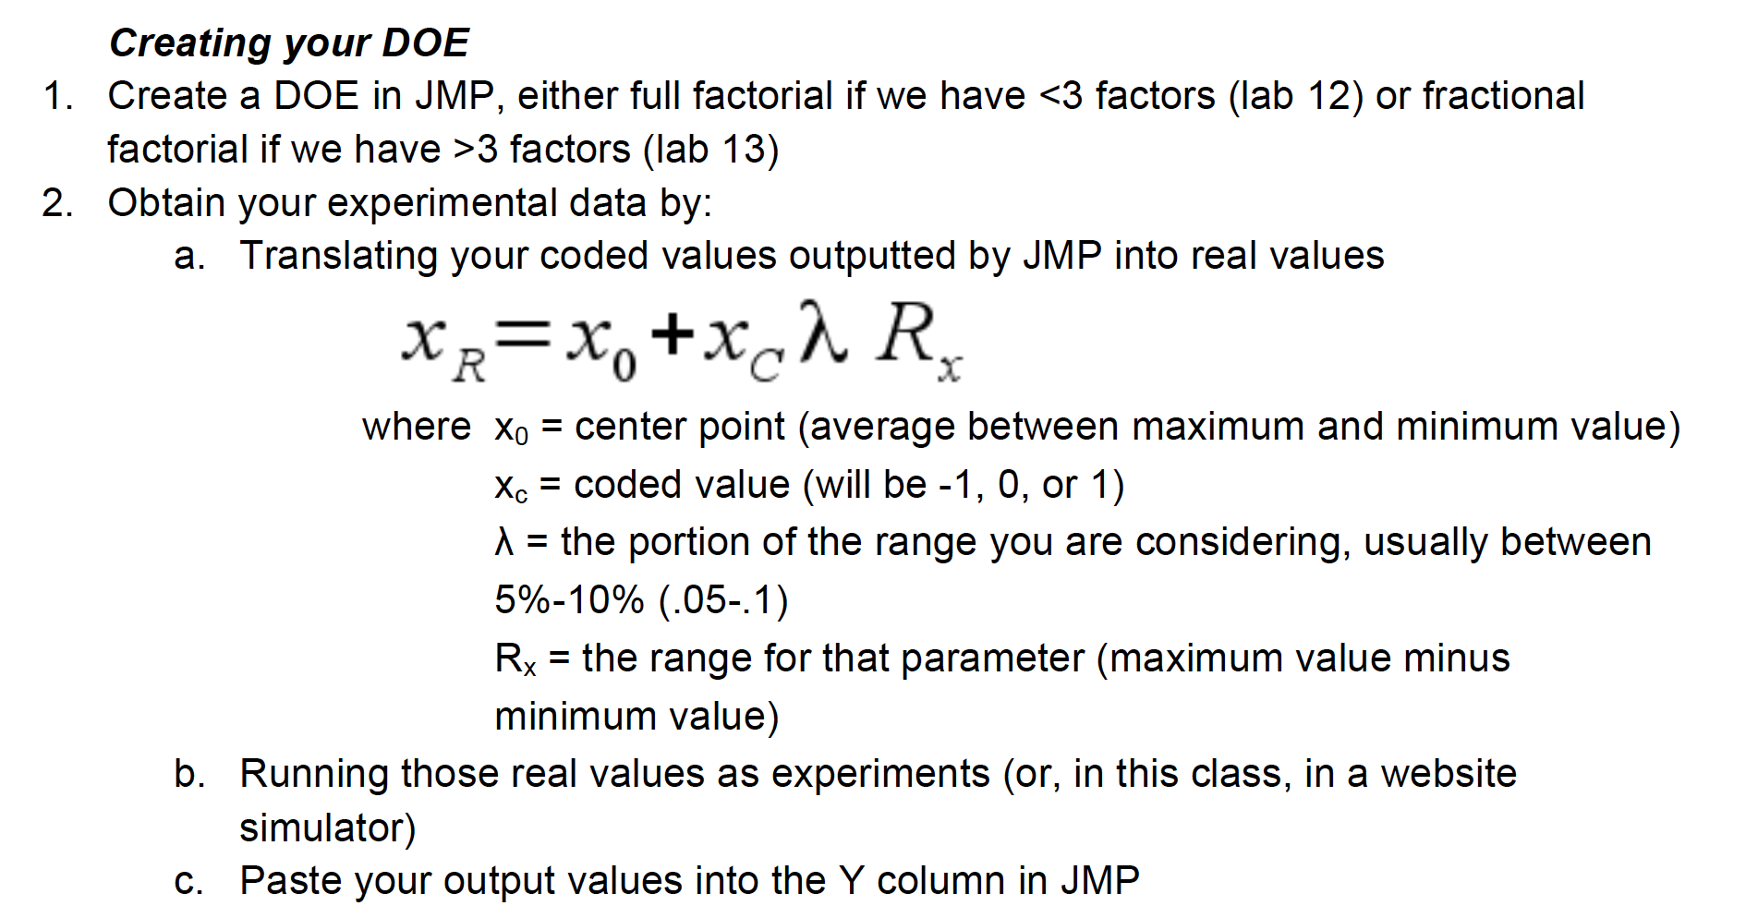
Step 2: Screening

Slide 4
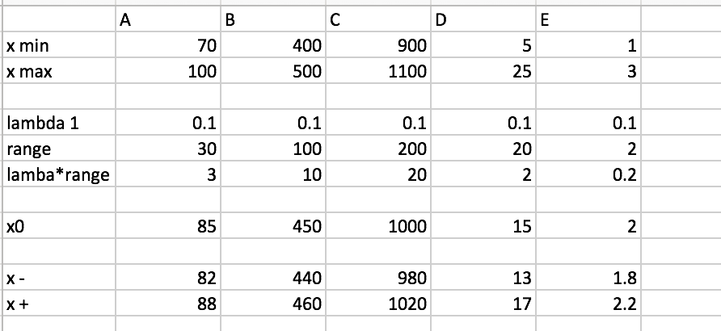
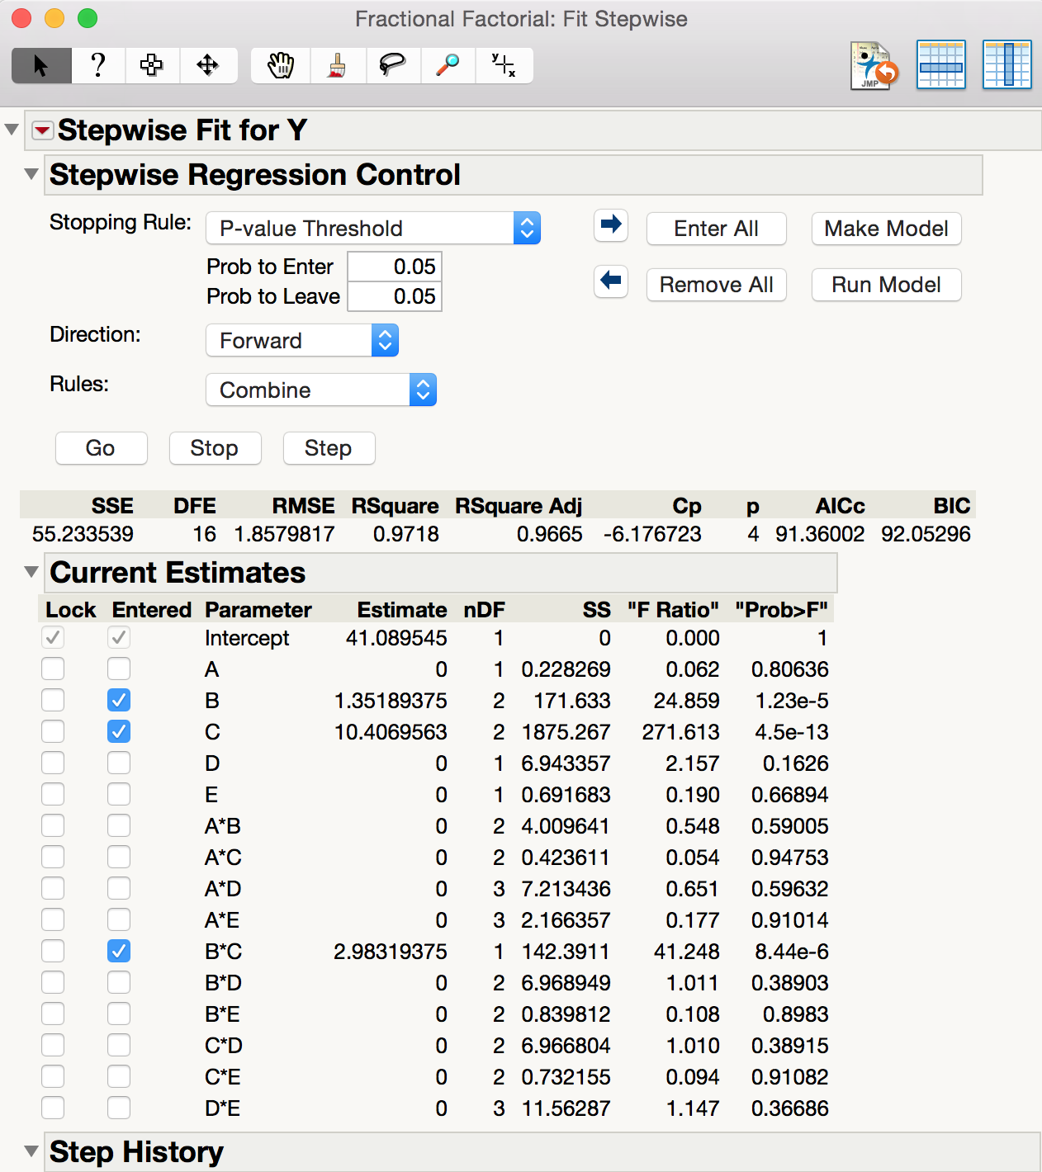
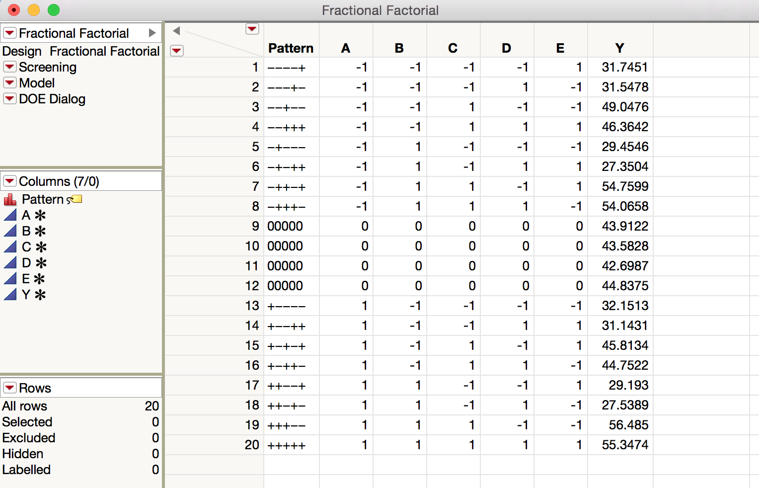
Done in screening section of the excel sheet
Observe B and C to be the significant main effects
But are they near the optimum values?
All other factors are fixed at the values corresponding to the maximum production rate

Slide 5
Step 3: Refining the regression model in region of interest
Since we have only two significant factors, we can perform a full factorial DOE around x₀
x₀ corresponds to the conditions at which we got the maximum production rate for our screening DOE
Only the factors that are significant change; fix insignificant factors to their value for the maximum production rate
Choose a lower value of lambda

Slide 6
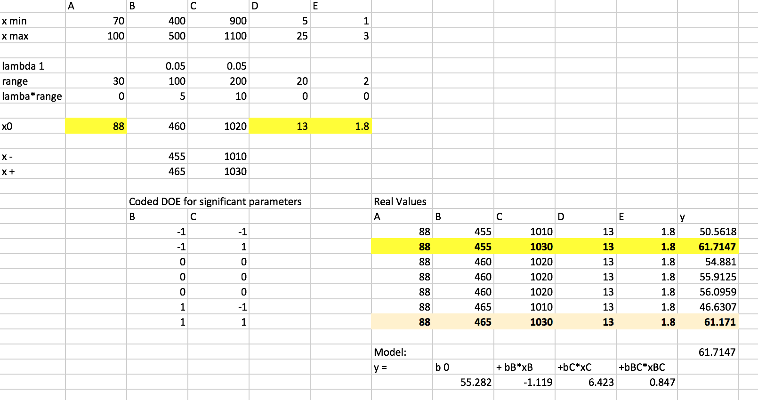
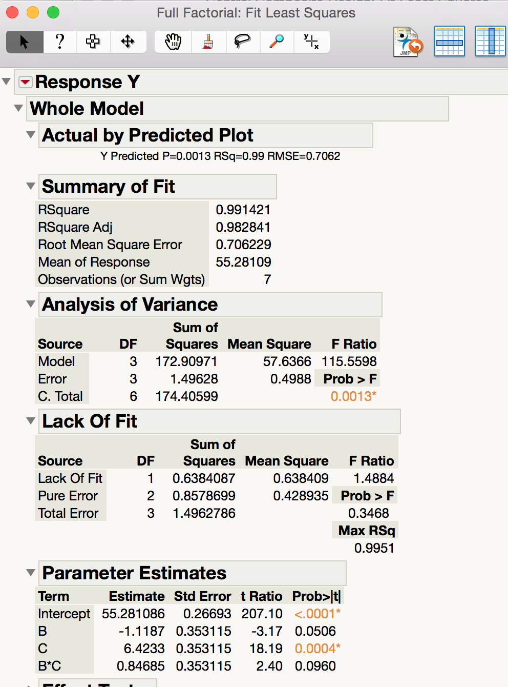
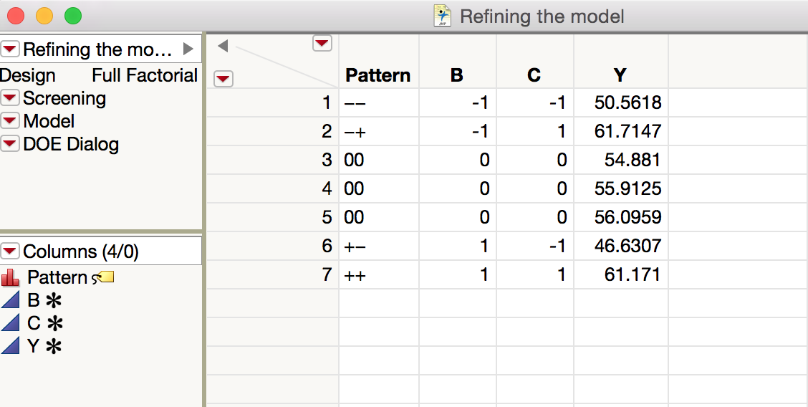
Observe B is borderline significant, hence do not eliminate
Observe C is very significant
The maximum response conditions will be the x₀ for our next step
Now perform steepest ascent to go closer to optimum conditions

Slide 7
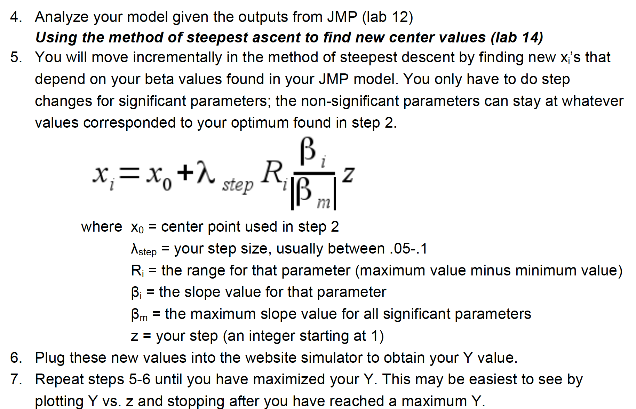
Step 4: Steepest ascent for the significant factors
.05-.01

Slide 8
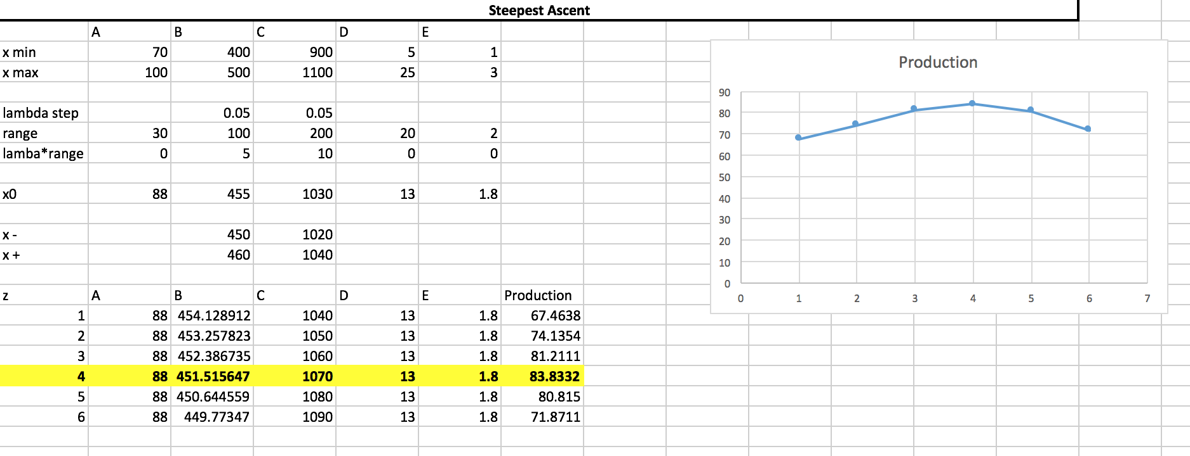
The optimized conditions will be the x₀ for the next step

Slide 9
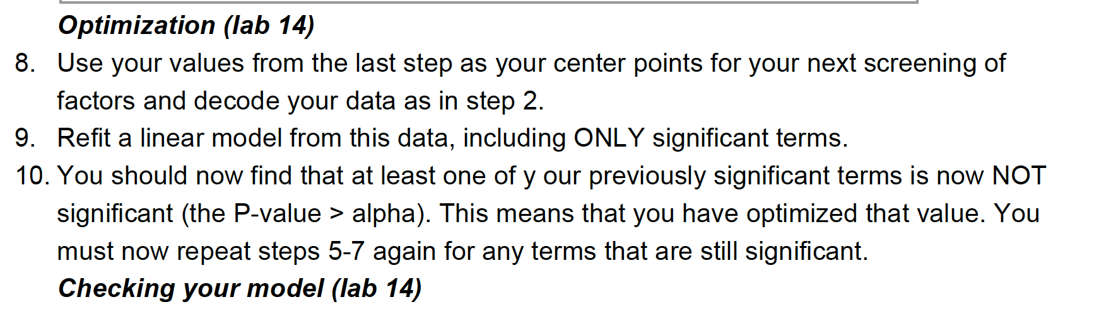
Step 5: Check for contour significance
We have reached a maximum response, but are we at the peak yet?
Test the significance of the factors again using another factorial design
x₀ is now the optimum condition from the steepest ascent step

Slide 10
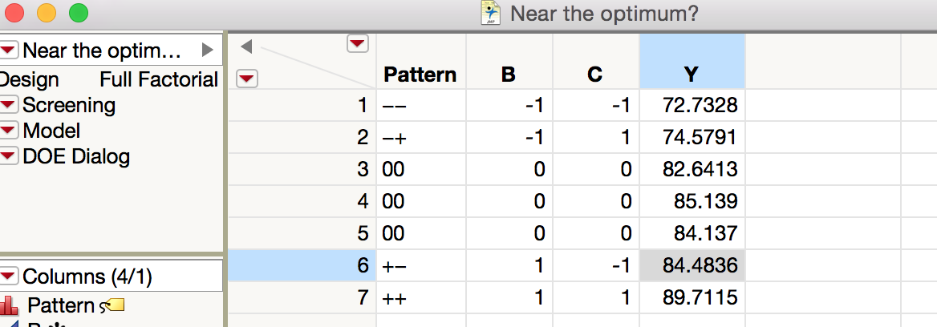
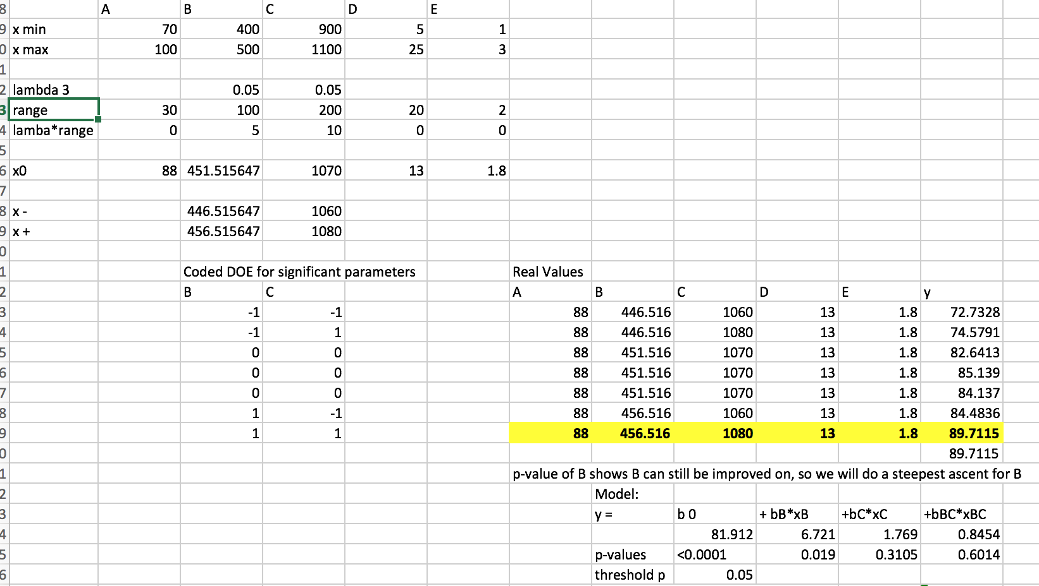
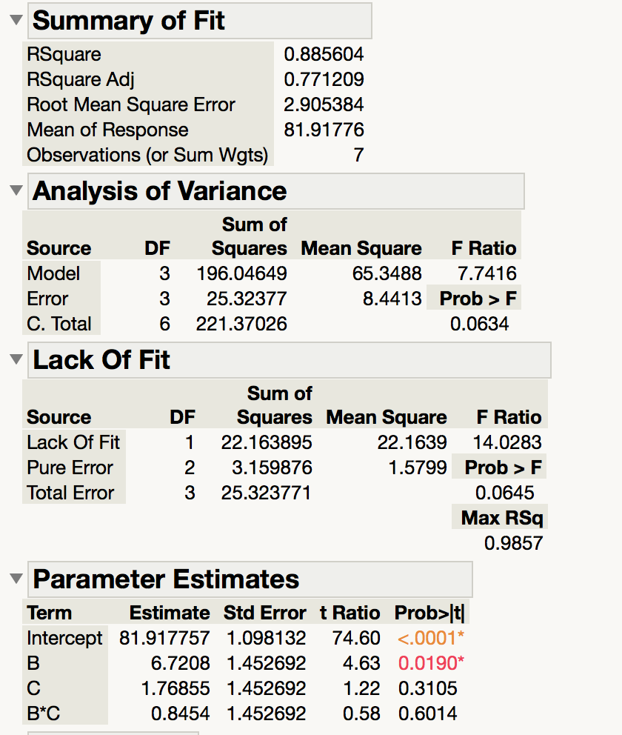
P-value of B indicates that it can still be refined. Therefore, perform a steepest ascent step on B
All other factors are insignificant in the region of interest
The conditions corresponding to the maximum response will be our x₀ for the steepest ascent

Slide 11
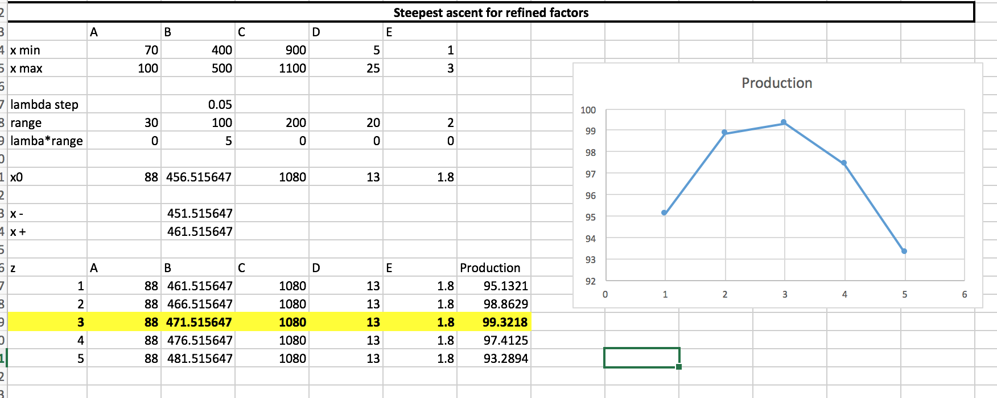
Step 6: Steepest Ascent for the remaining factors
B is our only remaining factor
Perform steepest ascent for B using the obtained regression model
Assume all factors are now in region of optimal response
Proceed to CCD analysis using the optimized operating conditions of this step as the x₀

Slide 12
Step 7: Central Composite Design Analysis
We have our optimal region
This analysis will further refine it to the exact values
We need at least two factors to do the analysis
Depending on number of runs left at hand, decide on number of factors to be used for this step
**Note that we are exceeding the number of desired runs
Using this example, think of possibilities to reduce the runs
Step | Runs Used | Cumulative used (Desired 50)
Step 1: Fractional Factorial | 20 | 20
Step 2: Refining slope | 7 | 27
Step 3: Steepest Ascent | 6 | 33
Step 4: Testing contour region | 7 | 40
Step 5: Steepest Ascent 2 | 5 | 45
Step 6: CCD Analysis | 10 | 55

Slide 13
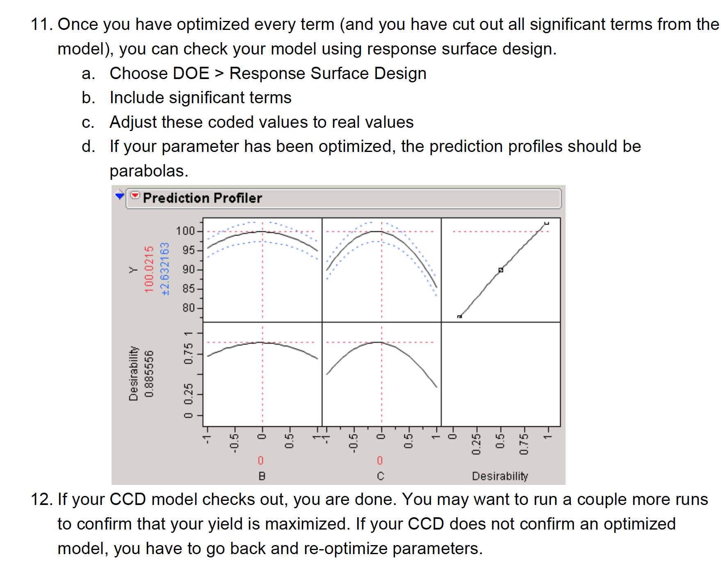

Slide 14
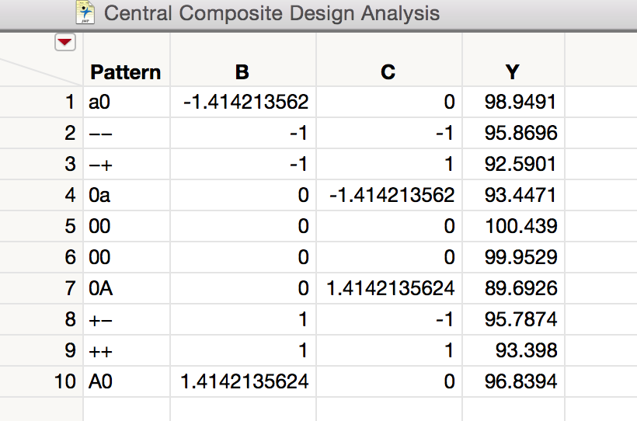
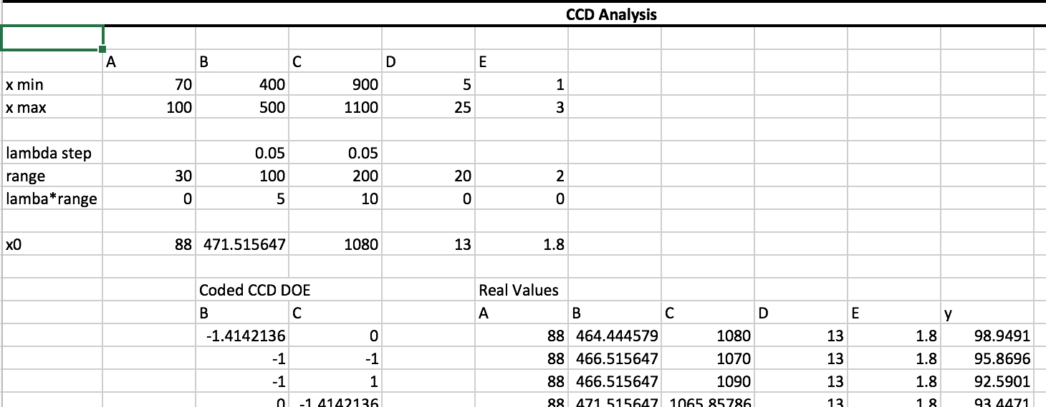
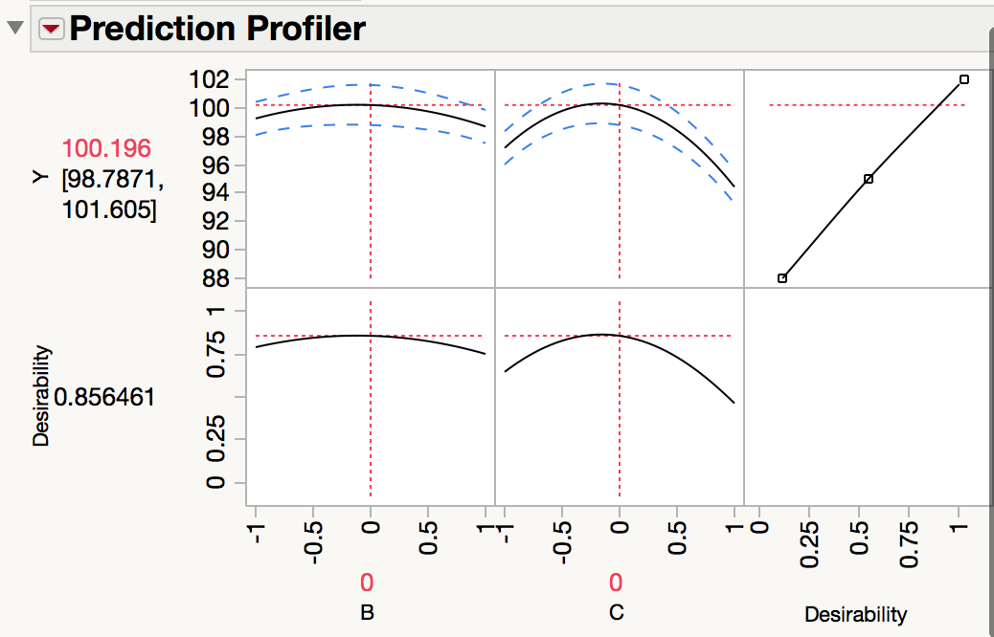
Observe concave down Y vs factor plots for ALL the significant factors
Suggests that we have reached an optimum value

Slide 15
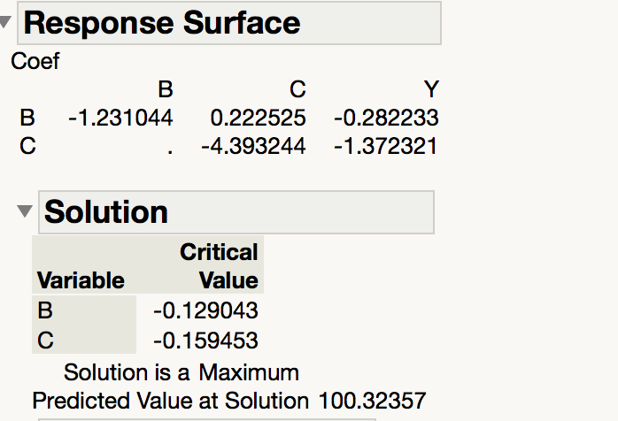
Step 8: Get the optimized conditions
Using the critical value (it is coded for the significant factors) outputted in the CCD analysis, convert to the real values using the step length, etc.
This approximates the value for the optimum operating conditions
All other insignificant factors are optimized en route to the CCD analysis

Slide 16
Attachments
JMP and Excel sheets of the analysis are enclosed

